Slide 1


Information Horizon of Flares and Magnetic Active Regions
March 23, 2022
Jay R Johnson, Elmer Rivera, Carson O’Ffill, Jonathan Homan, Jesse Snelling, Simon Wing, Mausumi Dikpati
Andrews University
Applied Physics Laboratory, Johns Hopkins University
UCAR/High Altitude Observatory

Slide 2
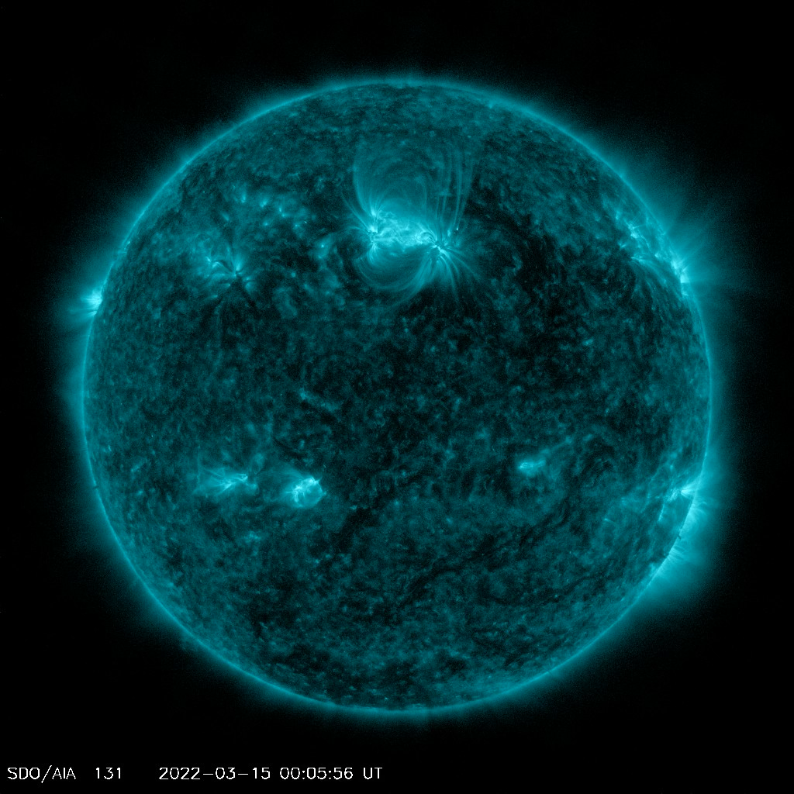
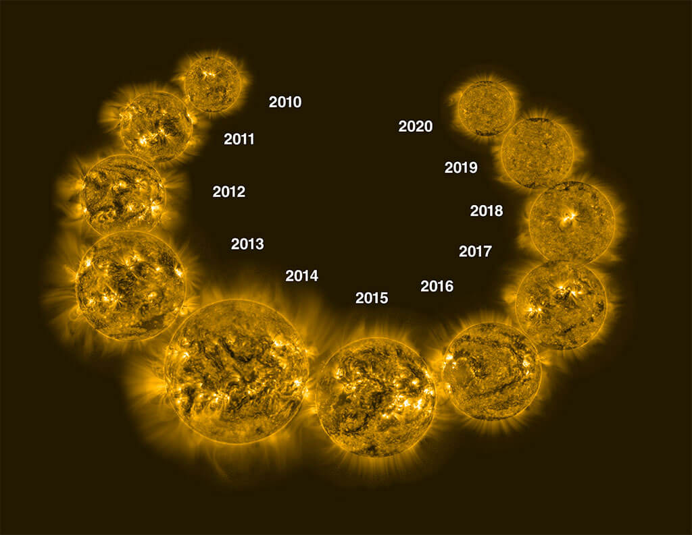
A Hierarchy of Timescales
Rotation
27-35 days
Flares (seconds to hours)
Solar Cycle
11 year
Collage by NOAA/JPL-Caltech

Slide 3
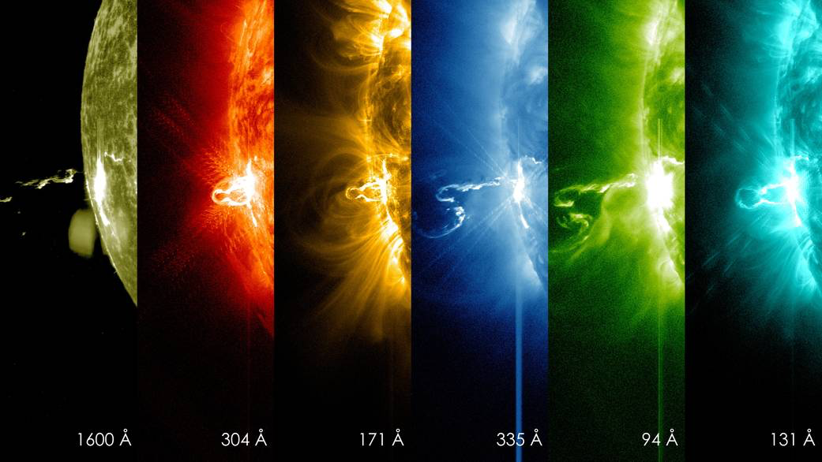
Solar Flares
Nasa.gov

Slide 4
A Hierarchy of Timescales
Δ₁
Δ₂
Δ₃
Δ₄
Δ₅
Δ_{6 …}

Slide 5
Data and Bayesian Block Decomposition
GOES observations
72000 accepted flares > C1 class
Time period 1975-2017
Mean = 4.83 hrs
Scargle [2012]
Mean block length ~ 24 days
Variance in rate corresponds to solar cycle
Notes:
Mean wait: 4.83 hrs. Approximately 72,000 accepted flares. Bayesian Blocks decomposition of flare firing rate. Mean block length is 24 days, which is on the order of solar rotational period (previous research has thought this is a reasonable timescale for assuming the processes are stationary). Variance of the rate corresponding to solar cycle is easily visible.

Slide 6
Waiting Time Distribution
1975-present
72,000 flares
Mean 4.85 hours
Nonstationary Poisson Distribution
Wheatland [2002], Moon [2001], Ashwanden [2010], …
Snelling et al., 2020

Slide 7
Non-Stationary Poisson Process?
The waiting time distribution is consistent with the assumption of independent events having an exponential distribution of waiting times.
This is a property of avalanche models and Self Organized Criticality

Slide 8
Question: Although the distribution matches is it really a nonstationary Poisson process or are subsequent flares actually related? Is there a short-term memory?
Notes:
The BB WTD is the ‘analytic’ distribution given the bayesian block decomposition given in Wheatland (2002).
The stationary Poisson distribution uses the mean firing rate given earlier.
Discrepancy at small waiting time possibly due to observational problems differentiating flare(Wheatland 2002)

Slide 9
Mutual Information Example
Heads
Tails
P_{h} | P_{t} | P_{hh} | P_{ht} | P_{th} | P_{tt} | I
1/2 | 1/2 | 10/46 | 12/46 | 12/46 | 12/46 | .004
1/2 | 1/2 | 22/46 | 1/46 | 1/46 | 22/46 | 0.82
1/2 | 1/2 | 0 | 1/2 | 1/2 | 0 | 1.0
time
Same distributions, different information!

Slide 10
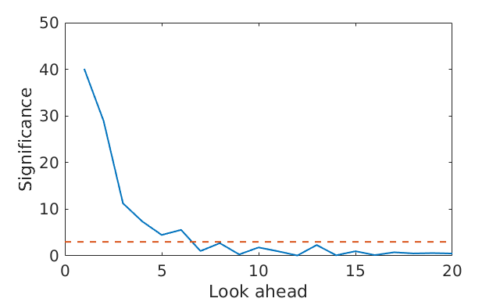
Significance of Difference of MI from Surrogates
S =|MI-<MI_{S}>|/σ_{S}
S>3 for ~30 hours
Suggests subsequent flares have dependence on timescale < 1 day
~30 hours (short term memory)
3σ confidence level
Notes:
Significance (solid blue line) vs look ahead for the entire period (1974-2018). The dashed red line is shown at a significance of 3, illustrating that significant information persists to a look ahead of 6. Mean wait: 4.83 hrs. So memory is significant on the order of 30 hours.

Slide 11
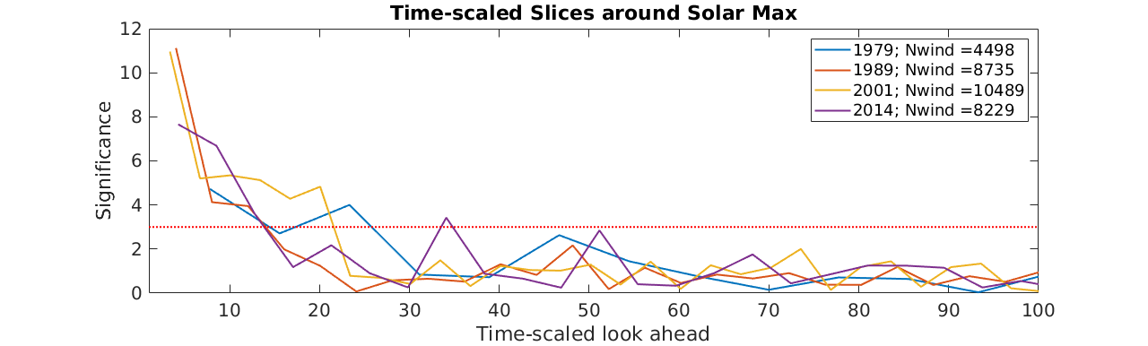
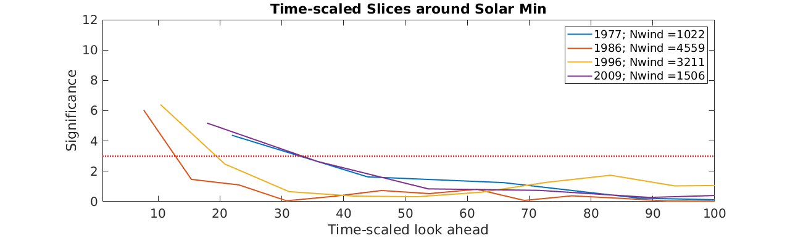
Notes:
Top: Slices of the contour centered at solar Max.
Bottom: Slices of the contour centered at solar Min. Note that the number of data points in the windows for solar min is much less, resulting in poorer statistics/significance.

Slide 12
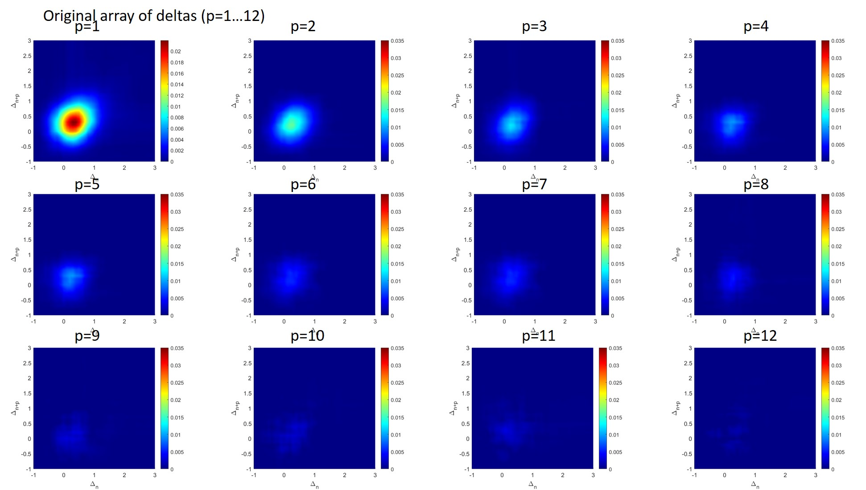
Difference of CDF of Flares and Surrogates CDF(Δ_{n}, Δ_{n+p}) - CDF(Δ_{n}, Δ_{n+p})_{surrogates}
p=1

Slide 13
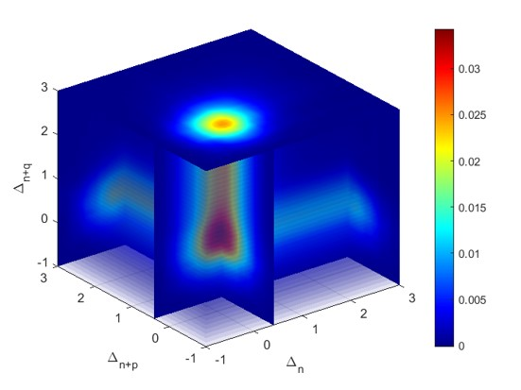
Clustering of Flares CDF(Δ_{n}, Δ_{n+p},Δ_{n+2p}) - CDF(Δ_{n}, Δ_{n+p}, Δ_{n+2p})_{surrogates}
Consistent with about 10% of flares being clustered

Slide 14
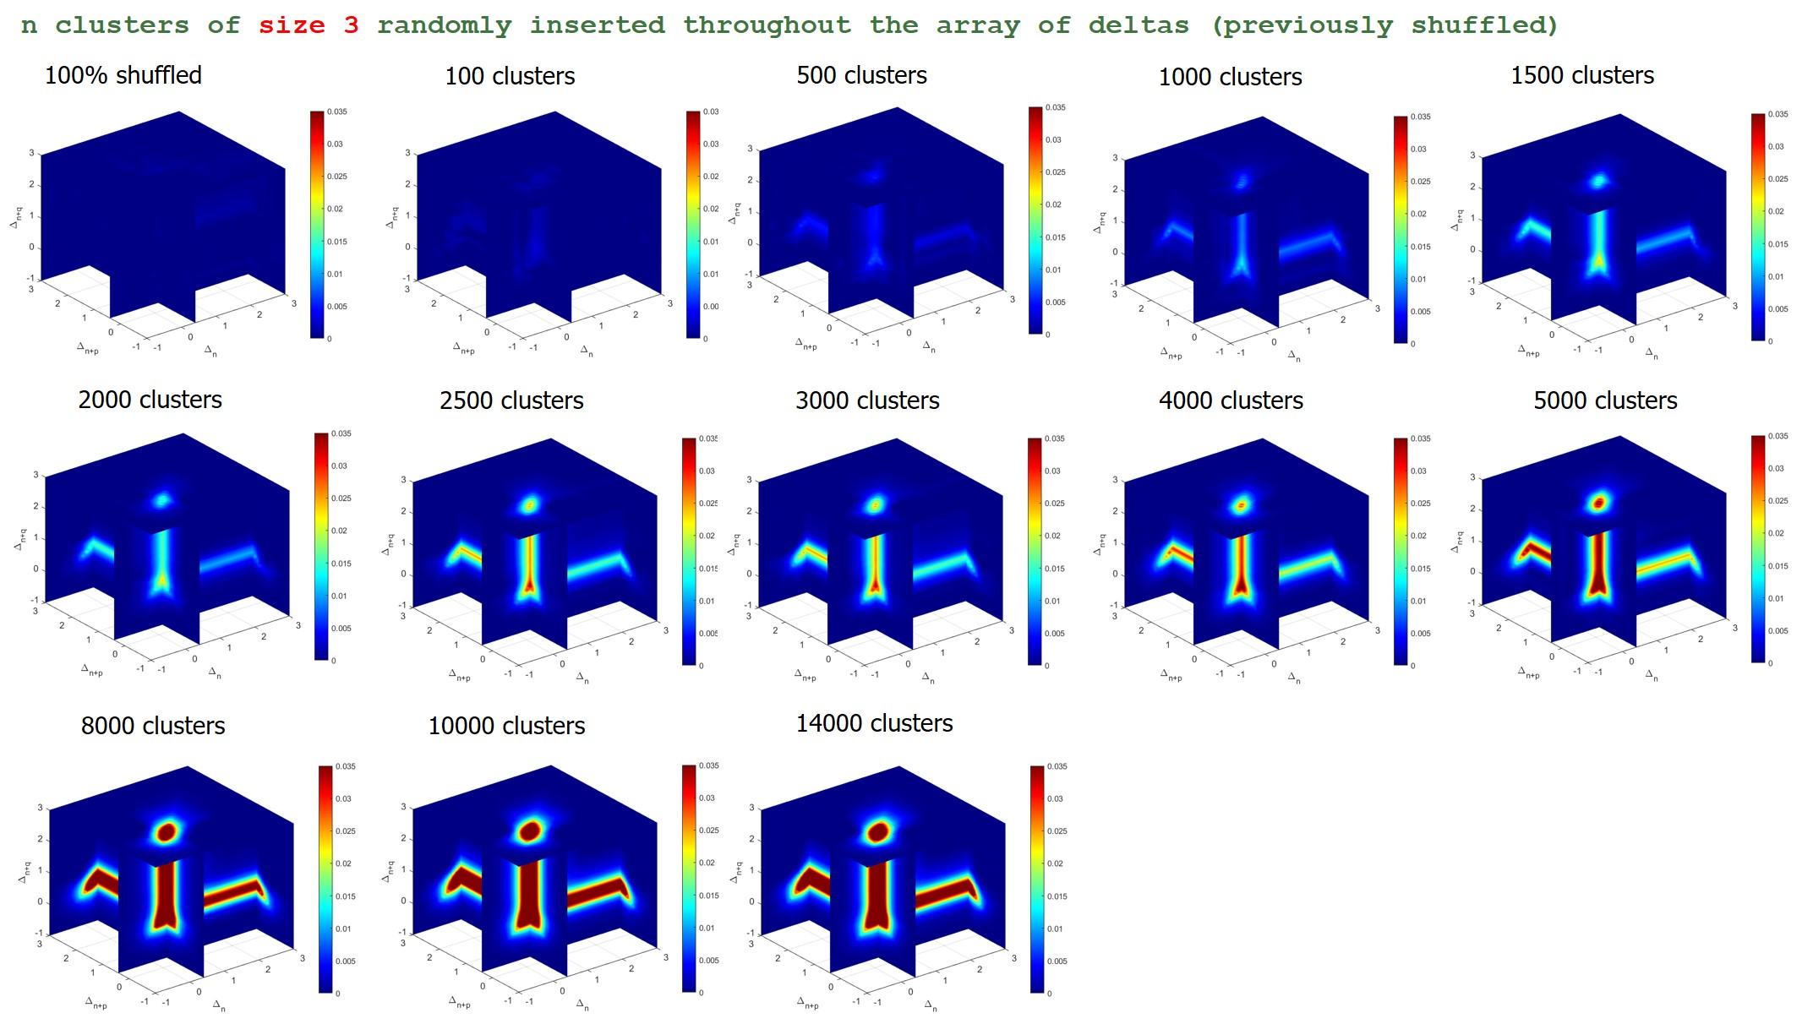
Artificial Clusters in Data

Slide 15
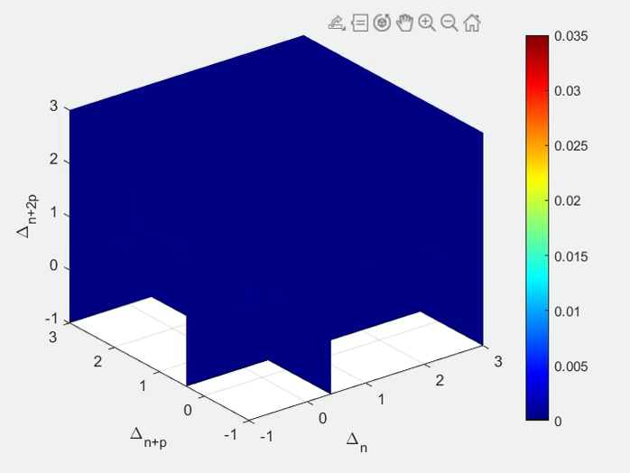
Clustering of Flares CDF(Δ_{n}, Δ_{n+p},Δ_{n+2p,}Δ_{n+3p})
Consistent with about 10% of flares being clustered

Slide 16
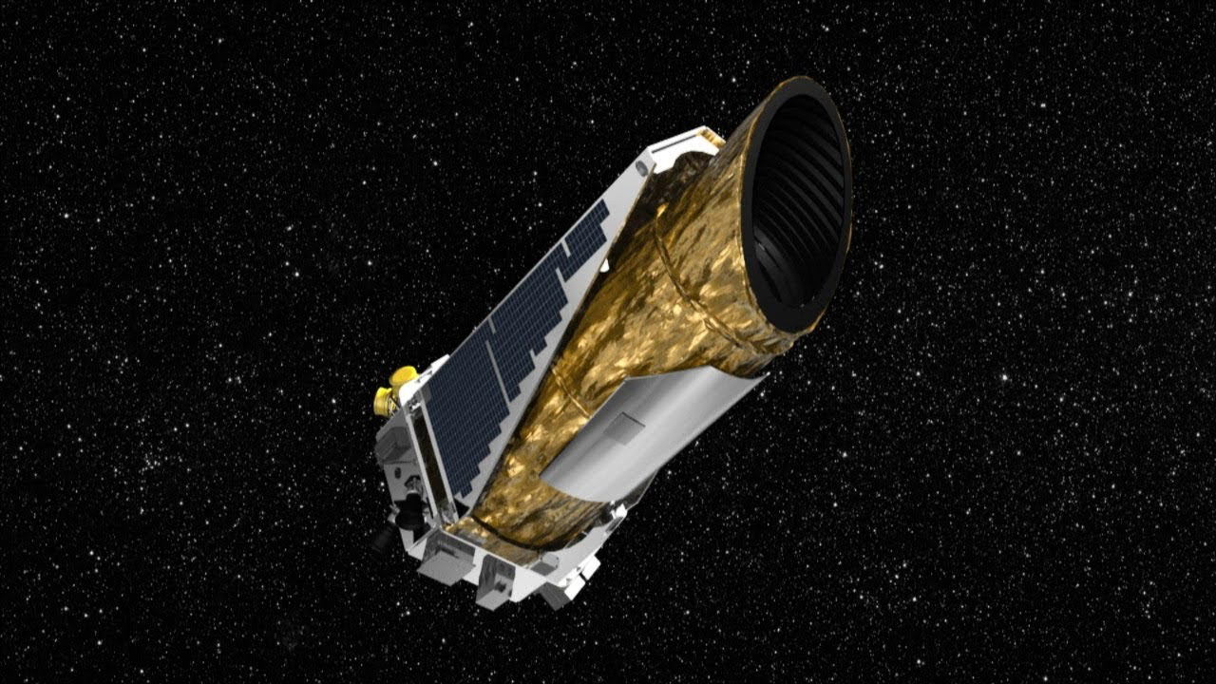
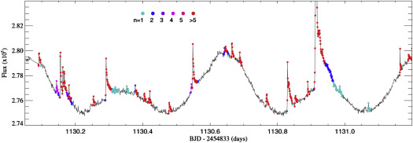
What about other stars?
Basri, 2019

Slide 17
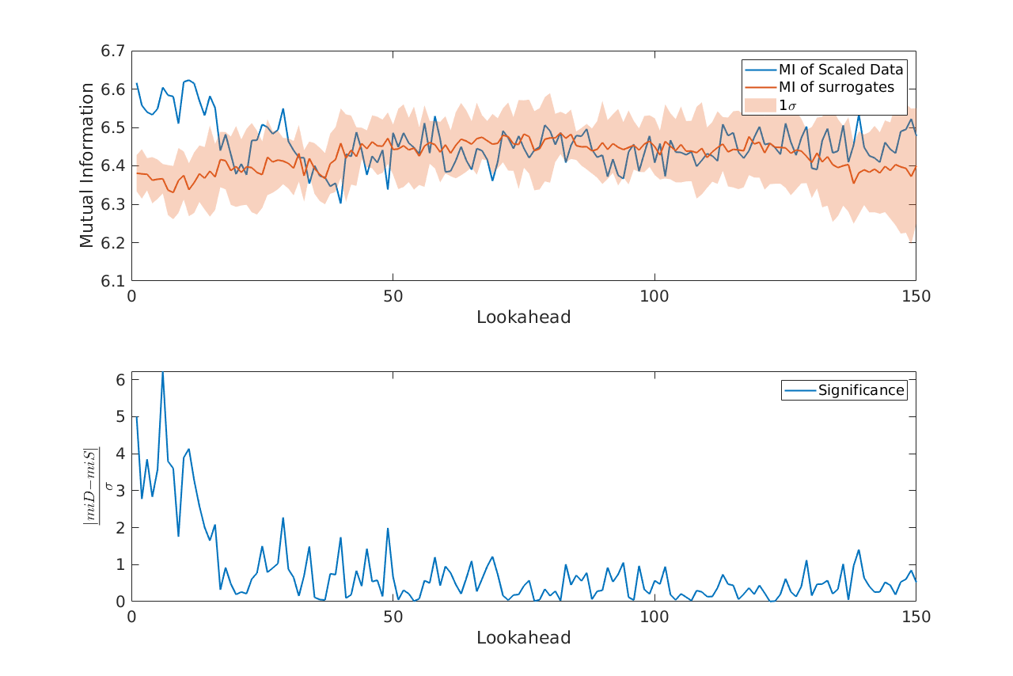
Application to Sun-like star KIC 4749912
Mutual information of the scaled data shows a similar relationship between subsequent flares
Evidence of sympathetic flares on solar-like stars

Slide 18
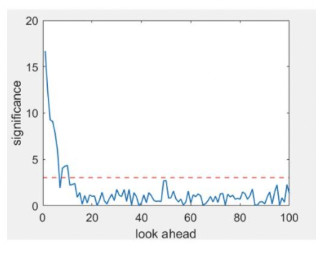
Solar Class Stars (Davenport, 2016)
Key issue: not enough data from sun-like stars to get good statistics
Consider 77 sun-like stars from Davenport survey each with different flare rates
Renormalize to create an ensemble of flare sequences with the same rate
Determine MI

Slide 19
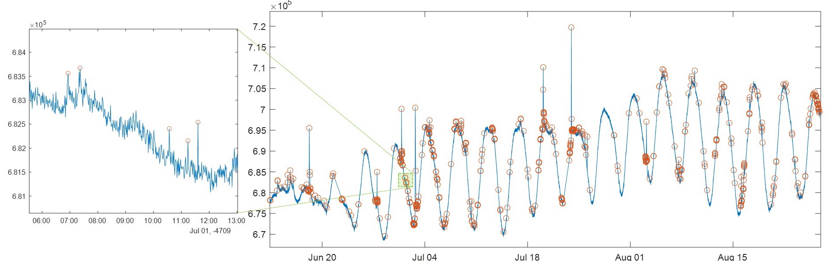
Noise or Flares?
Typical flare criterion signal > 3σ
What happens if we take a lower threshold?

Slide 20
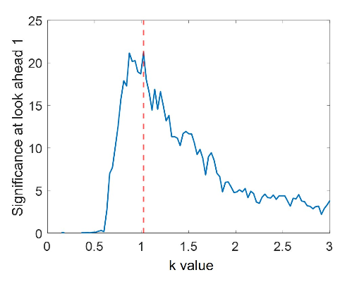
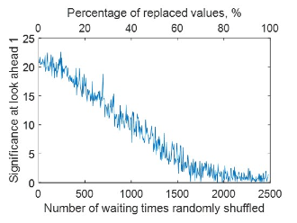
Small Flares Inconsistent with Noise
Reduction of threshold increases the information content of the flare sequence, so the “noise” actualy contains information inconsistent with random noise
Random replacement of flares leads to a reduction in information content. 70% of flares must be replaced before the significance drops implying that much of the apparent noise is real signal.

Slide 21
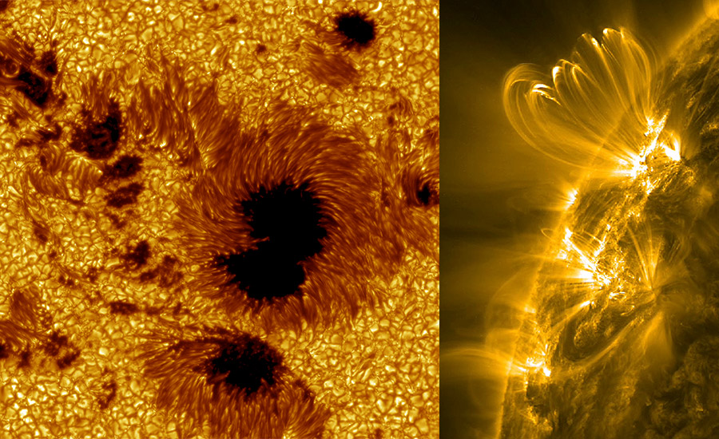
Solar Active Regions
https://scied.ucar.edu/image/solar-active-regions-sunspots-uv-image

Slide 22
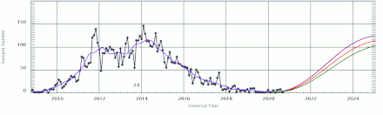
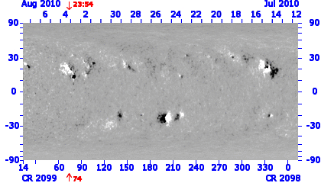
Overall Objective
Determine the information flow and information horizon of active regions.
Dataset will be a sequence of magnetogram synoptic maps of Carrington rotations
Use tools of entropy, mutual information, and conditional mutual information to characterize and compare maps
GONG/SDO

Slide 23
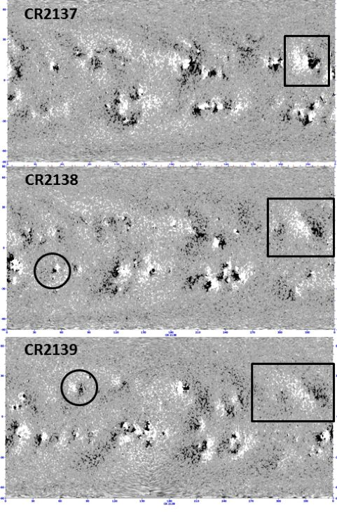
Overall Objective
Determine the information flow and information horizon of active regions.
Dataset will be a sequence of magnetogram synoptic maps of Carrington rotations
Use tools of entropy, mutual information, and conditional mutual information to characterize and compare maps
GONG/SDO

Slide 24

Entropy-Based Tools
Entropy provides a measure of disorder, so can be used to identify order in an image
Based on probability of pixel values
H(x) = - ΣP(x) log(P(x))

Slide 25
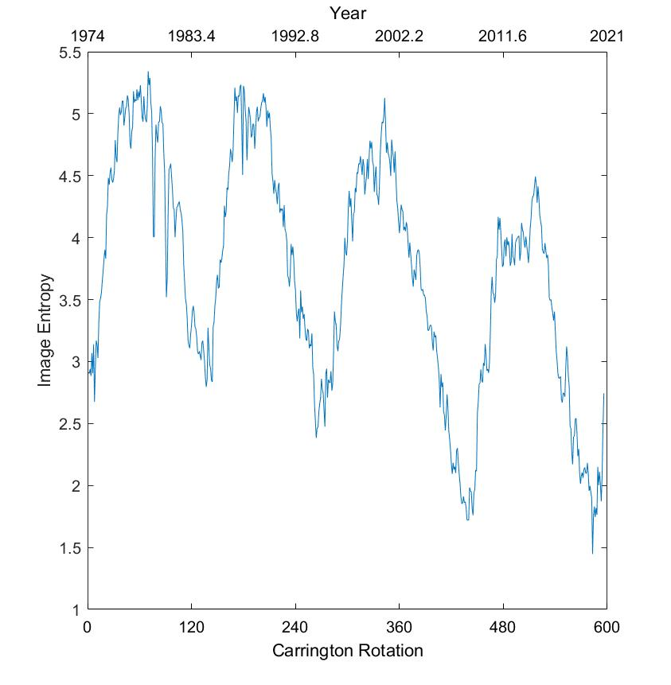
Entropy of Synoptic Maps
The high entropy times correspond to more active regions where there is more variability in the synoptic maps.
Autocorrelation peaks at 140 CRs (solar cycle)

Slide 26

Entropy-Based Tools
Mutual Information compares two images and provides a measure of similarity.
MI(x,y) = H(x) + H(y) – H(x,y) where x and y are pixels of different images

Slide 27
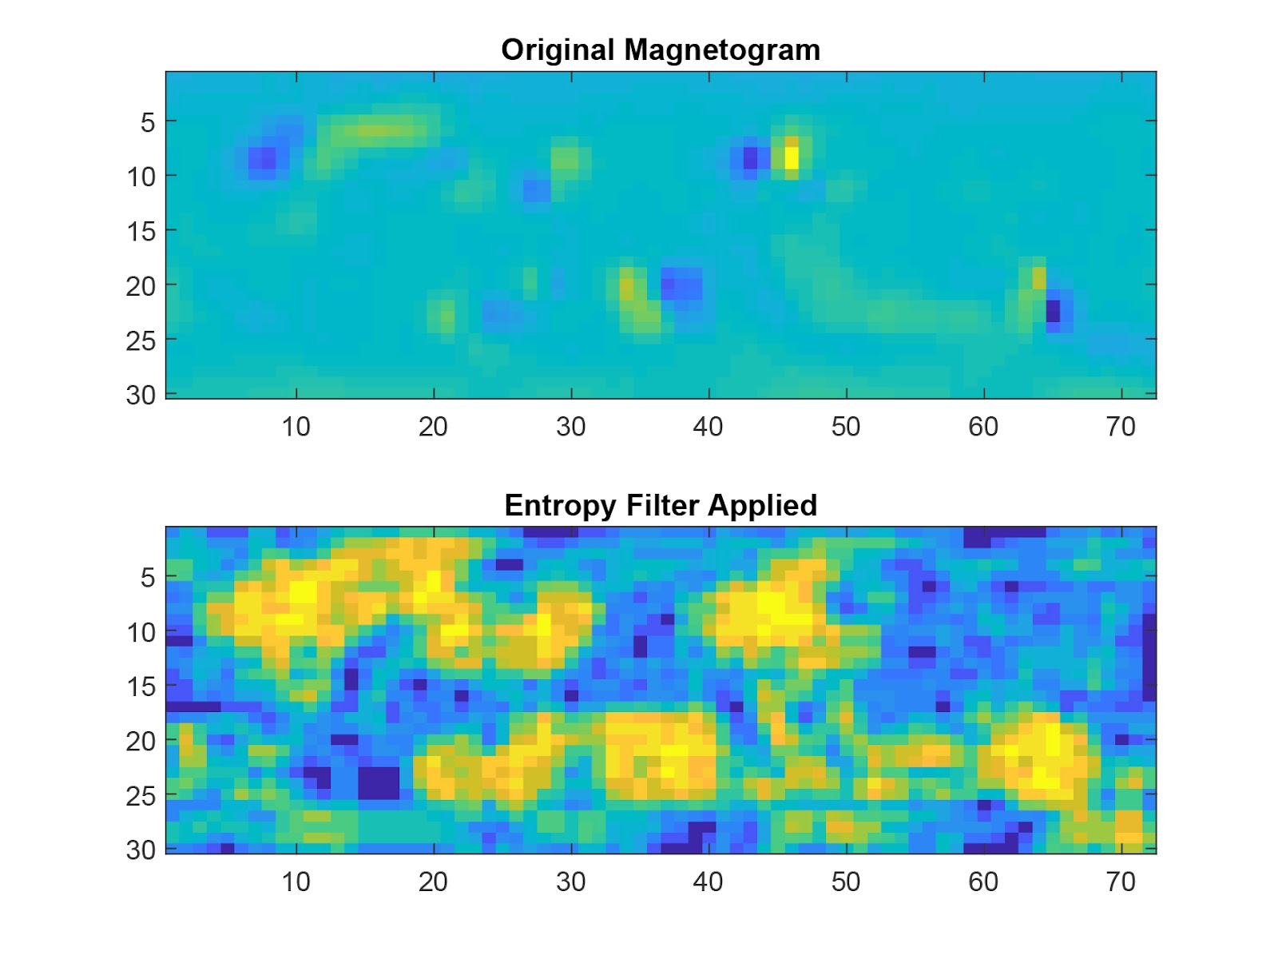
Procedure
Apply entropy filter to identify solar active regions
Use the entropy filter to mask the original magnetogram
Identify partitions for comparison between images (allows us to follow structures)
Compare MI of the partitions

Slide 28
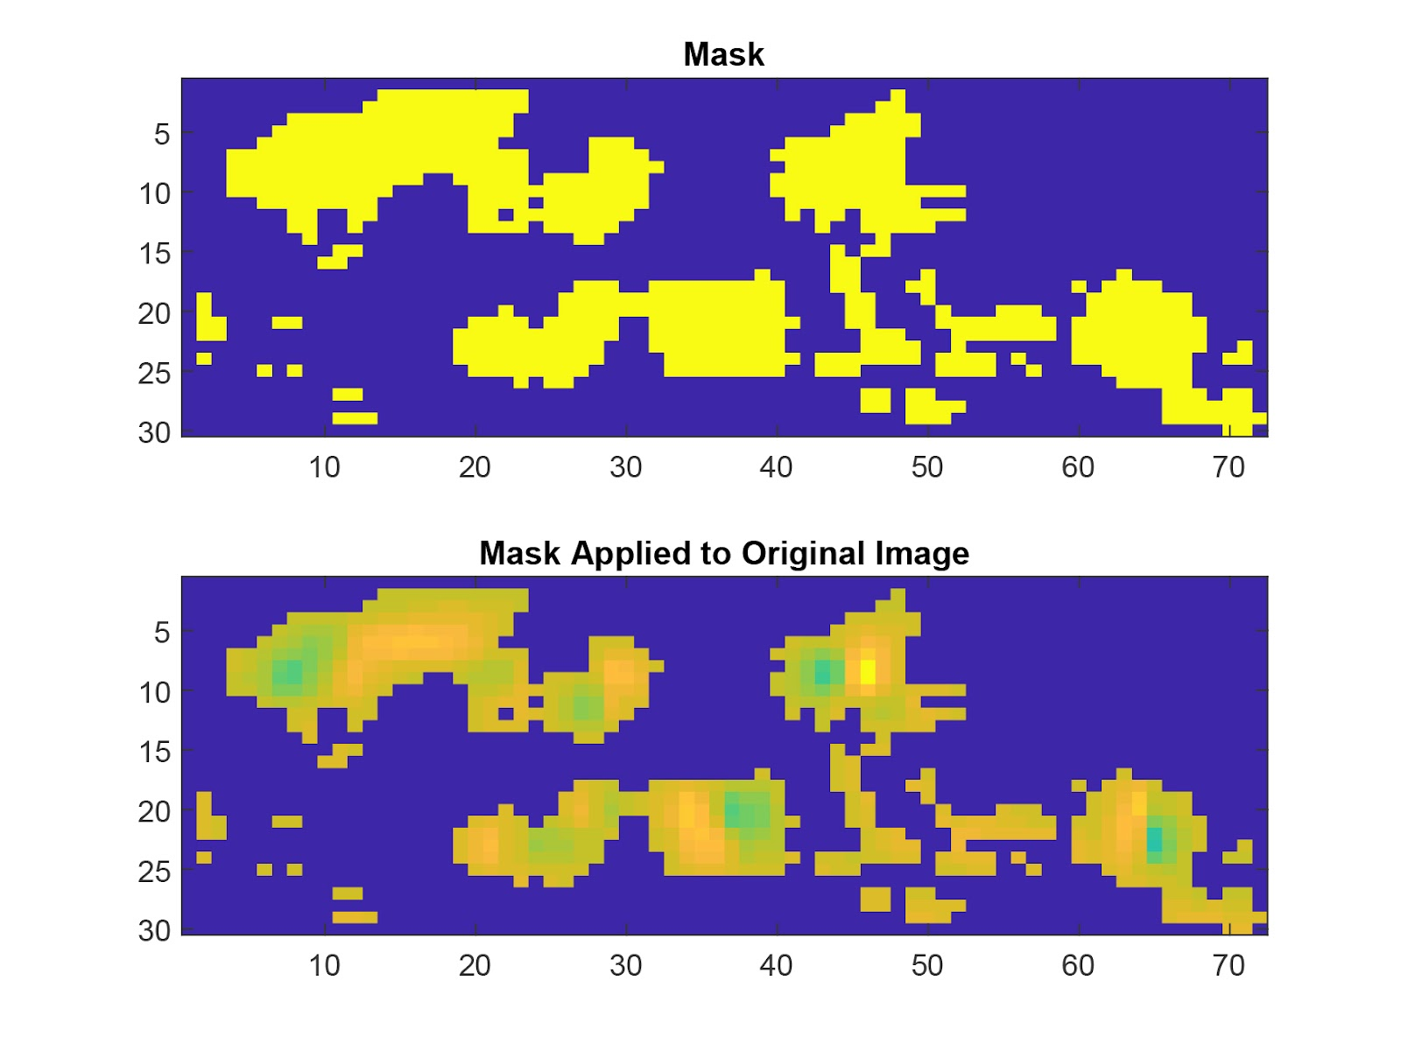
Procedure
Apply entropy filter to identify solar active regions
Use the entropy filter to mask the original magnetogram
Identify partitions for comparison between images (allows us to follow structures)
Compare MI of the partitions

Slide 29
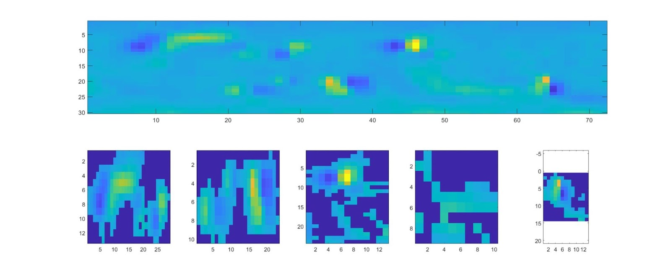
Procedure
Apply entropy filter to identify solar active regions
Use the entropy filter to mask the original magnetogram
Identify partitions for comparison between images (allows us to follow structures)
Compare MI of the partitions

Slide 30
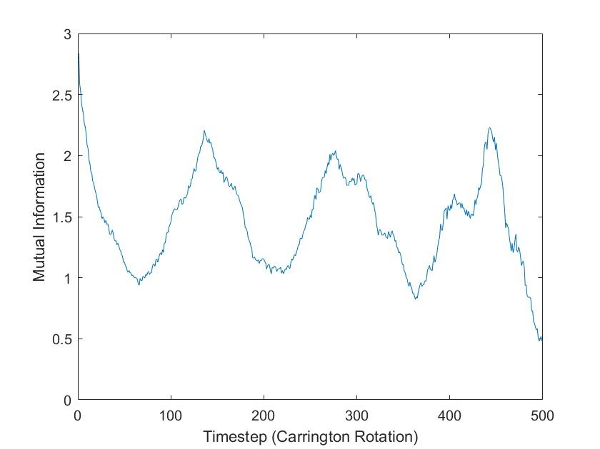
Results: Mutual Information
Shows characteristic timescale for loss of coherence of structures (~20 CR)
Shows similarity of structures at next cycle (140 CR)

Slide 31
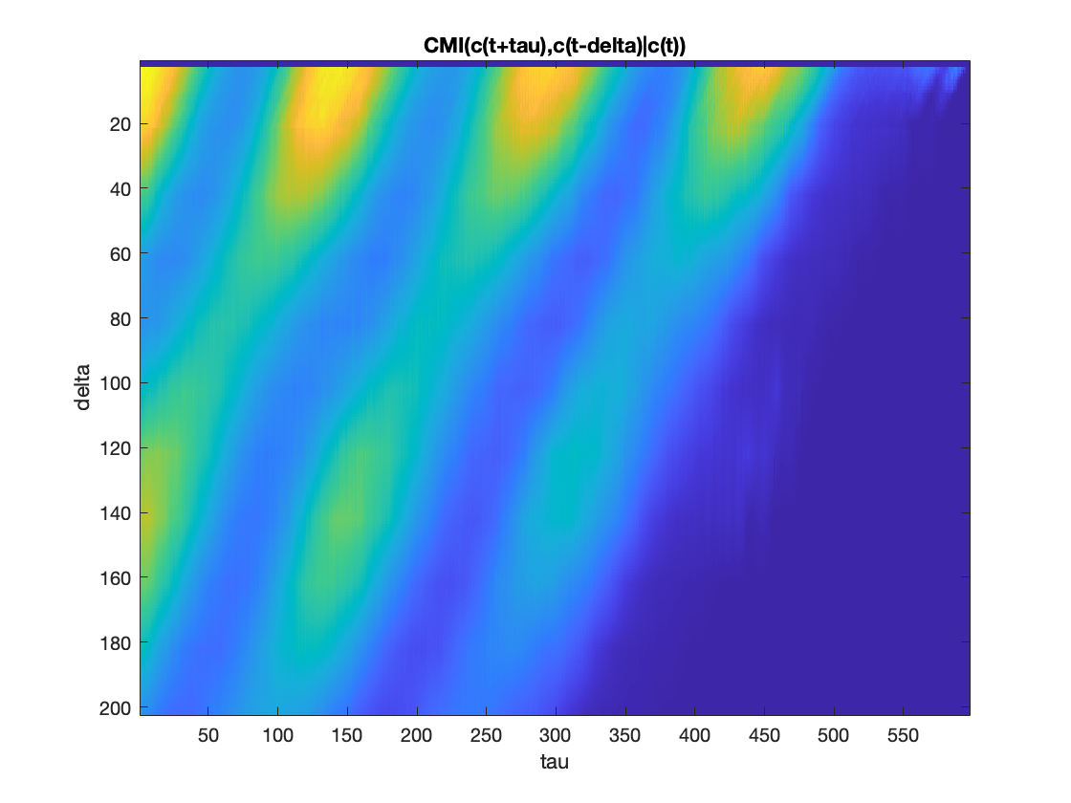
Conditional Mutual Information
CMI(X,Y|Z) provides a measure of how much additional information is provided by a variable
Look Behind
Look Ahead

Slide 32
Summary
Flare dynamics is not consistent with a nonstationary Poisson process.
Information theory identifies a short-term memory in flares that lasts about 1 day and is associated with clustering of flares (consistent with around 10% of flares being clustered.
Information flow suggests that coherence of active region structures decays away on a timescale of 20 CR.
Peaks at 140 CR (solar cycle) indicate similar dynamics at 1 solar cycle.
Residual information remains after excluding information from the past solar cycle. The residual information is large at two solar cycles and drops off with time indicating long-term memory.

Slide 33
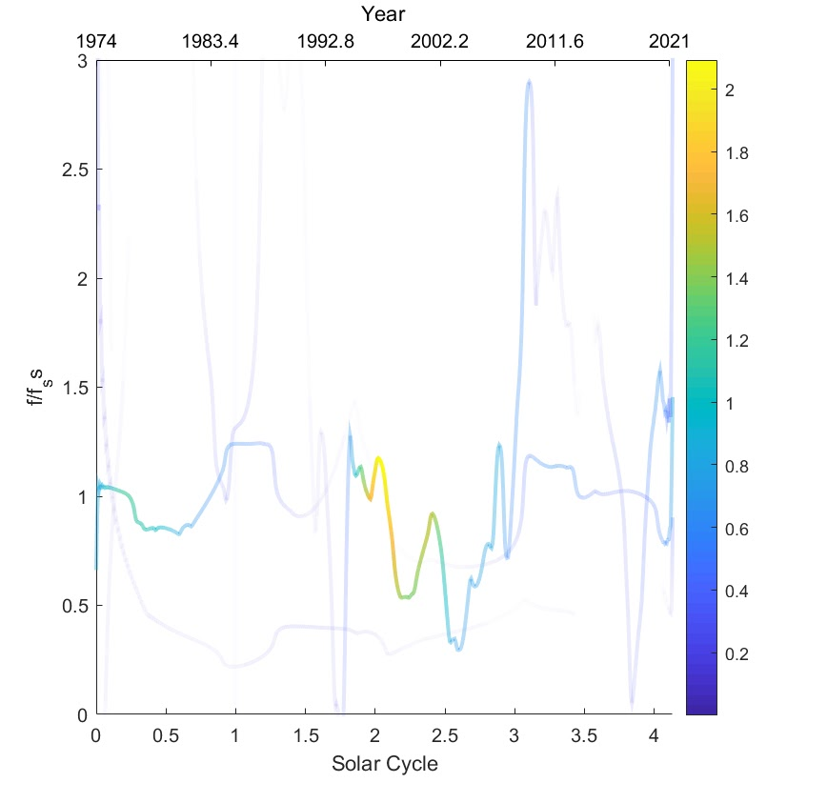
Hilbert Spectrum and Solar Cycle Memory
The Hilbert-Huang transform provides a measure of instantaneous frequency
Extracts out empirical modes having a hierarchy of timescales

Slide 34
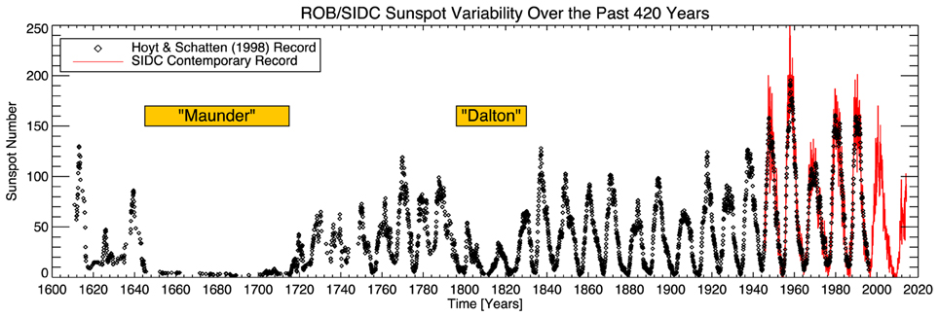
22 year memory

Slide 35
Summary
Information theory provides a useful method to identify and track active regions.
Information flow suggests that coherence of structures decays away on a timescale of 20 CR.
Peaks at 140 CR (solar cycle) indicate similar dynamics at 1 solar cycle.
Residual information remains after excluding information from the past solar cycle. The residual information is large at two solar cycles and drops off with time indicating long-term memory.

